Slide 1
CS5100: Foundations of Artificial Intelligence Informed search algorithms
Dr. Rutu Mulkar-Mehta
Lecture 2

Slide 2
Administrative
Assignment P0 – How many did it?
Project 1- How many started it?

Slide 3
Review from Lecture 1
Agents and Agent types
Agents to perform search
Uninformed Search Techniques
Breadth First Search
Depth First Search
Uniform Cost Search
Iterative Deepening Search
Notes:
Roomba Agent, Self Driving Cars agent etc
Search – Pacman Agent

Slide 4

Terminology
Start and Goal
Parent Node
Child Node
Fringe or Frontier
Next list of nodes to be expanded
Search Strategy
BFS, DFS, UCS etc.

Slide 5
Space Time Complexity
Time: Number of nodes generated during the search
Space: Maximum number of nodes stored in memory

Slide 6
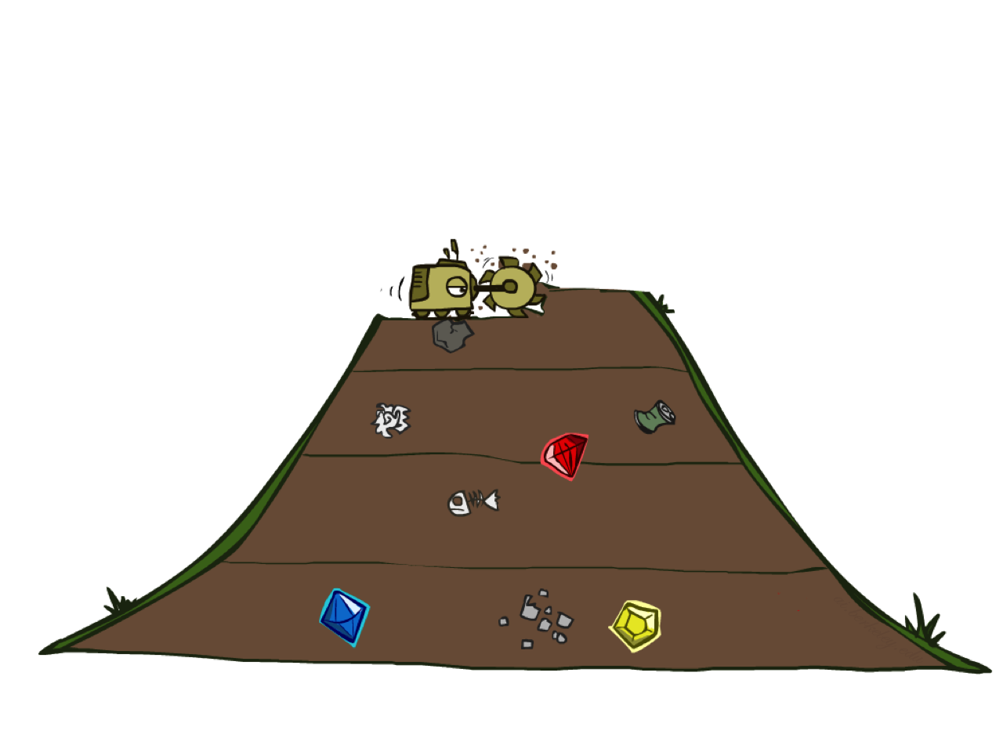
Review: BFS
Starts with the root node and explores all neighboring nodes
Repeats this for every one of those
This is realized in a FIFO queue
It does an exhaustive search until it finds a goal.

Slide 7
Review: BFS
BFS is complete
(i.e. it finds the goal if one exists and the branching factor is finite).
It is optimal (Finds best solution)
(i.e. if it finds the node, it will be the shallowest in the search tree).

Slide 8
Review: BFS
Space: O(b^{d})
Time: O(b^{d})
b = branching factor
d = depth to which BFS is reached

Slide 9

Review: DFS
Explores one path to the deepest level and then backtracks until it finds a goal state.
This is realized in a LIFO queue (i.e. stack).

Slide 10
Review: DFS
DFS is complete
(if the search tree is finite).
It is not optimal
(it stops at the first goal state it finds, no matter if there is another goal state that is shallower/better than that).

Slide 11
Review: DFS
Space: O(bm)
Much lower than BFS
Time: O(b^{m})
(Higher than BFS if there is a solution on a level smaller than the maximum depth of the tree).
Danger of running out of memory or running indefinitely for infinite trees.
b = branching factor
m = maximum depth

Slide 12
Review: Iterative Deepening DFS
The search depth for DFS increased iteratively over time, gradually increasing the maximum depth to which it is applied.
This is repeated until finding a goal.
Combines advantages of DFS and BFS.
It is complete.
It is optimal (the shallowest goal state will be found first, since the level is increased by one every iteration).

Slide 13
Review: Iterative Deepening DFS
Space: O(bd)
(better than DFS, d is depth of shallowest goal state, instead of m, maximum depth of the whole tree).
Time: O(b^{d})
b = branching factor
m = maximum depth

Slide 14

Review: Uniform Cost Search
Expand lowest path cost
Demands the use of a priority queue

Slide 15
Uniform Cost Search
Space: O(b^{1+C/e})
Time: O(b^{1+C/e})
→ Can be much greater than b^{d}
C = cost of optimal solution
e = cost of every action
b = branching factor
m = maximum depth

Slide 16
Issues with all these above techniques
We don’t know if we are going in the right direction
we need more information about the problem space to solve the problem effectively

Slide 17

Today
Informed Search
Problem Specific Knowledge is provided
This is beyond the definition of the problem itself
This information can be used to find solutions more efficiently than uninformed search

Slide 18
Today
Best-first search
Greedy best-first search
A* search

Slide 19
Best-first search
Implementation:
Order the nodes in fringe in decreasing order of desirability
Idea: use an evaluation function f(n) for each node
estimate of "desirability” Expand most desirable unexpanded node
f(n) is based on the heuristic h(n)
Special cases:
greedy best-first search
A* search
Notes:
Fringe: Next set of nodes to Explore

Slide 20


Search Heuristics
A heuristic is:
A function that estimates how close a state is to a goal
Designed for a particular search problem
Examples: Manhattan distance, Euclidean distance for pathing
10
5
11.2

Slide 21
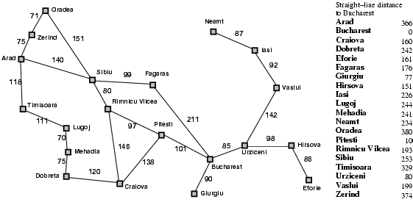
Example of Heuristic Function
h(x)

Slide 22

Greedy Search

Slide 23
Greedy best-first search
Evaluation function f(n) = h(n) (heuristic)
e.g. estimate of cost from n to goal
e.g., h_{SLD}(n)
straight-line distance from n to Bucharest
Greedy best-first search expands the node that appears to be closest to goal
Notes:
hshl(n) -> here n is any city

Slide 24

Greedy best-first search example

Slide 25

Greedy best-first search example

Slide 26

Greedy best-first search example

Slide 27

Greedy best-first search example

Slide 28
Properties of greedy best-first search
Complete? No
can get stuck in loops,
e.g., Iasi → Neamt → Iasi → Neamt →
Time? O(b^{m})
but a good heuristic can give dramatic improvement
Space? O(b^{m})
keeps all nodes in memory
Optimal? No

Slide 29
Greedy Best First: Incomplete

Slide 30
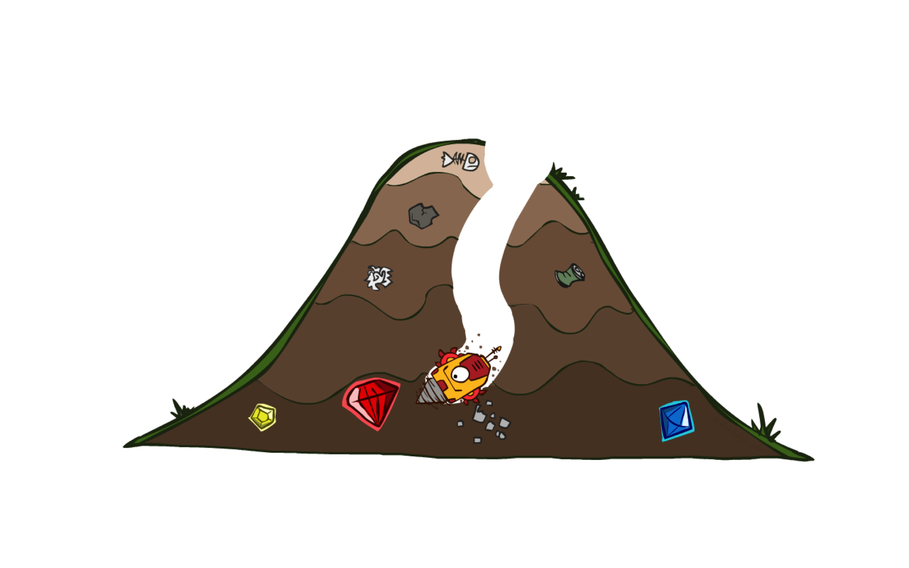
A* Search

Slide 31
A* search
Idea: avoid expanding paths that are already expensive
Evaluation function f(n) = g(n) + h(n)
g(n) = cost so far to reach n
h(n) = estimated cost from n to goal
f(n) = estimated total cost of path through n to goal

Slide 32
A* search and UCS
A* search is identical to UCS, except it uses g(n) + h(n) instead of h(n)

Slide 33
Combining UCS and Greedy
Uniform-cost orders by path cost g(n)
Greedy orders by goal proximity h(n)
A* Search orders by the sum: f(n) = g(n) + h(n)
8
g = 0 h=6
S
e
h=1
g = 1 h=5
a
1
1
3
2
g = 2 h=6
g = 9 h=1
S
a
d
G
b
d
g = 4 h=2
e
h=6
1
h=5
h=2
h=0
1
g = 3 h=7
g = 6 h=0
g = 10 h=2
c
b
c
G
d
h=7
h=6
g = 12 h=0
G

Slide 34

A* search example

Slide 35

A* search example

Slide 36

A* search example

Slide 37

A* search example

Slide 38

A* search example

Slide 39

A* search example

Slide 40
When should A* terminate?
Should we stop when we enqueue a goal?
No: only stop when we dequeue a goal
h = 2
A
2
2
S
h = 3
h = 0
G
2
B
3
h = 1
Notes:
First takes path via B -> 2 + 1 = 3 (path via A 2+ 4 =4 more expensive)
options
B-> G (cost = 6)
S-> A (cost = 4) -> pick this one
Options
A -> G (cost = 6)
B -> G (Cost =6)

Slide 41
Is A* Optimal?
h = 6
1
A
3
S
h = 7
G
h = 0
5
What went wrong?
We need estimates to be less than actual costs!
Notes:
options:
S-> G (cost = 5)
S-> A (est cost = 7)
Pick the first one
However actual cost of S-> A -> G = 4, which is less than the path picked. Heuristics were not good. Estimates should be less than actual costs

Slide 42

Admissible Heuristics

Slide 43

Idea: Admissibility
Inadmissible (pessimistic) heuristics break optimality by trapping good plans on the fringe
Admissible (optimistic) heuristics slow down bad plans but never outweigh true costs

Slide 44


Admissible Heuristics
A heuristic h is admissible (optimistic) if:
where is the true cost to a nearest goal
Examples:
Coming up with admissible heuristics is most of what’s involved in using A* in practice.
15

Slide 45

Optimality of A* Tree Search

Slide 46


Optimality of A* Tree Search
Assume:
A is an optimal goal node
B is a suboptimal goal node
h is admissible
Claim:
A will exit the fringe before B
…

Slide 47


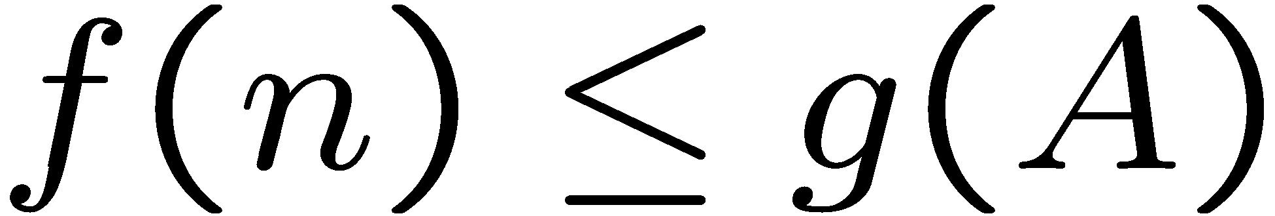
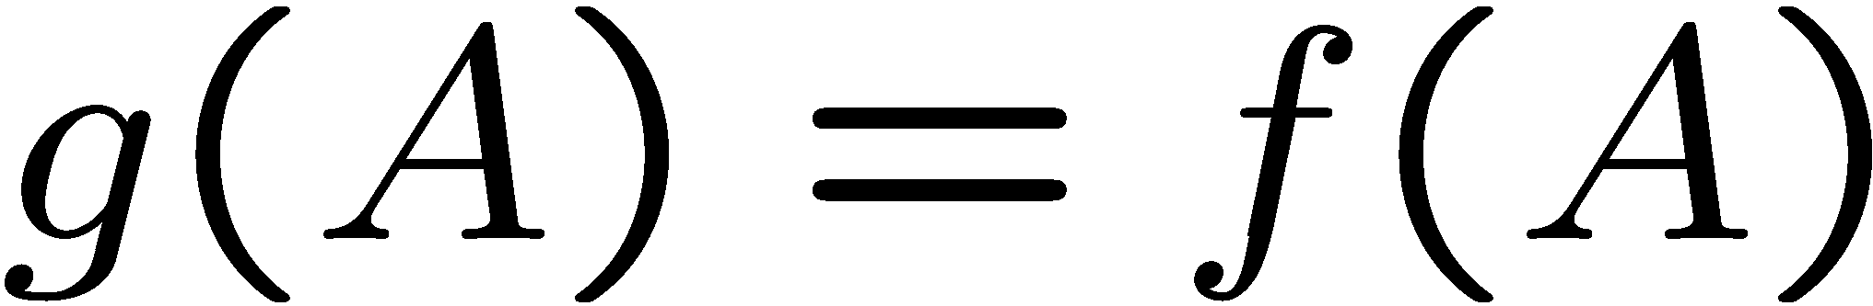
Optimality of A* Tree Search: Blocking
Proof:
Imagine B is on the fringe
Some ancestor n of A is on the fringe, too (maybe A!)
Claim: n will be expanded before B
f(n) is less or equal to f(A)
…
Definition of f-cost
Admissibility of h
h = 0 at a goal

Slide 48


Optimality of A* Tree Search: Blocking
Proof:
Imagine B is on the fringe
Some ancestor n of A is on the fringe, too (maybe A!)
Claim: n will be expanded before B
f(n) is less or equal to f(A)
f(A) is less than f(B)
…
B is suboptimal
h = 0 at a goal

Slide 49

Optimality of A* Tree Search: Blocking
Proof:
Imagine B is on the fringe
Some ancestor n of A is on the fringe, too (maybe A!)
Claim: n will be expanded before B
f(n) is less or equal to f(A)
f(A) is less than f(B)
n expands before B
All ancestors of A expand before B
A expands before B
A* search is optimal
…

Slide 50
Properties of A*

Slide 51
Properties of A*
Uniform-Cost
A*
b
b
…
…

Slide 52
UCS vs A* Contours
Uniform-cost expands equally in all “directions”
A* expands mainly toward the goal, but does hedge its bets to ensure optimality
Start
Goal
Start
Goal

Slide 53

Video of Demo Contours (Empty) -- UCS

Slide 54
Video of Demo Contours (Empty) -- Greedy

Slide 55
Video of Demo Contours (Empty) – A*

Slide 56
Video of Demo Contours (Pacman Small Maze) – A*

Slide 57



Comparison
Greedy
Uniform Cost
A*

Slide 58

Creating Heuristics

Slide 59
Creating Admissible Heuristics
Most of the work in solving hard search problems optimally is in coming up with admissible heuristics
Often, admissible heuristics are solutions to relaxed problems, where new actions are available
Inadmissible heuristics are often useful too
366
15
Notes:
A relaxation is an approximation of a difficult problem by a nearby problem that is easier to solve

Slide 60
Relaxed problems
A problem with fewer restrictions on the actions is called a relaxed problem
The cost of an optimal solution to a relaxed problem is an admissible heuristic for the original problem

Slide 61
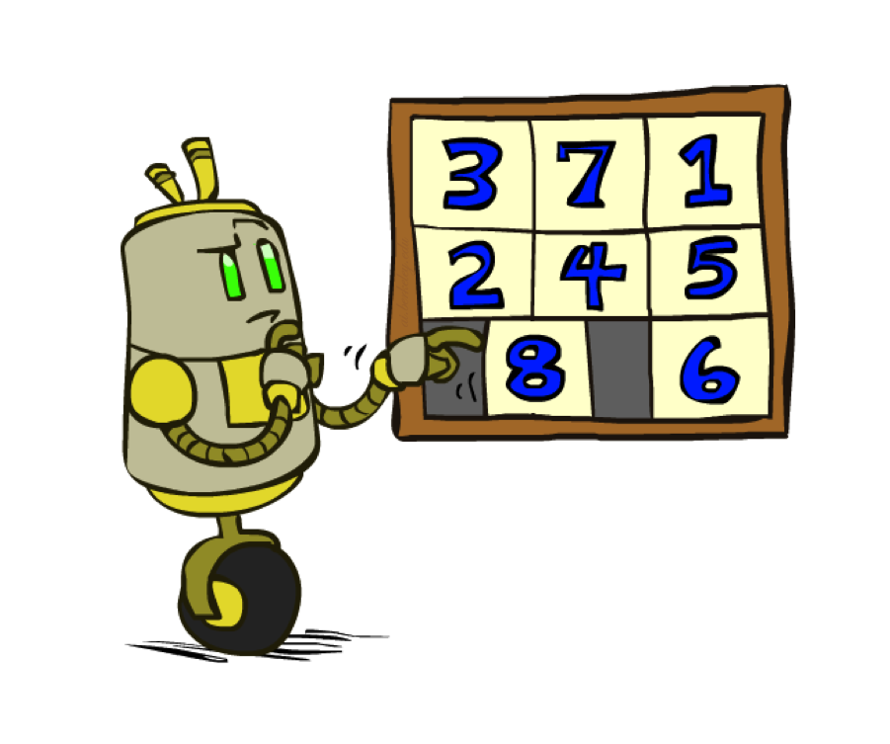
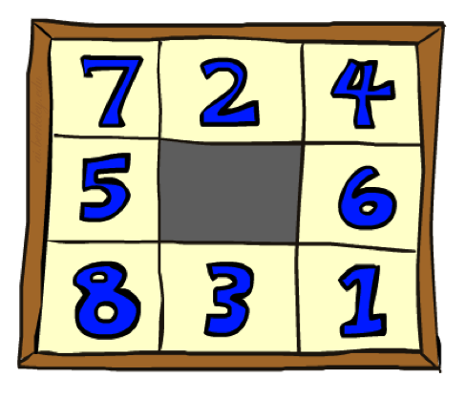
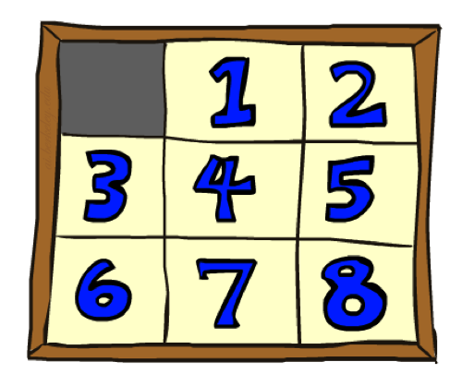
Example: 8 Puzzle
Start State
Actions
Goal State
What are the states?
How many successors from the start state?
Notes:
“half of the starting positions for the n-puzzle are impossible to resolve”

Slide 62
Example: 8 Puzzle
Start State
Actions
Goal State
How many states?
9!/2
half the states are impossible to solve
Notes:
“half of the starting positions for the n-puzzle are impossible to resolve”

Slide 63
Example: 8 Puzzle
Start State
Actions
Goal State
What is the branching factor?
If the average solution ~22 steps, what is the max depth that you would like to hit in a search tree?
Notes:
“half of the starting positions for the n-puzzle are impossible to resolve”

Slide 64
Relaxed problems
A problem with fewer restrictions on the actions is called a relaxed problem
The cost of an optimal solution to a relaxed problem is an admissible heuristic for the original problem
h₁(n): The number of Misplaced Tiles
h2(n): sum of distances of the tiles from their goal position

Slide 65
8 Puzzle - heuristics
h₁(n): The number of Misplaced Tiles
If the rules of the 8-puzzle are relaxed so that a tile can move anywhere, then h₁(n) gives the shortest solution
h2(n): sum of distances of the tiles from their goal position
If the rules are relaxed so that a tile can move to any adjacent square, then h₂(n) gives the shortest solution

Slide 66
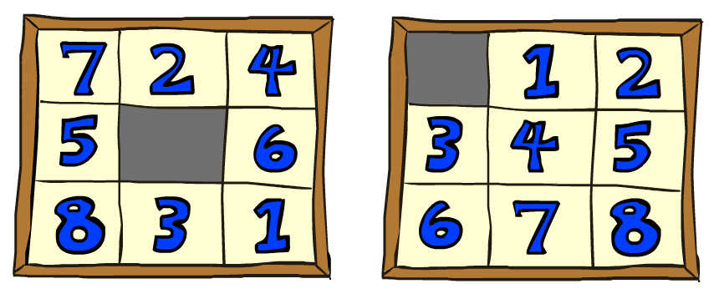
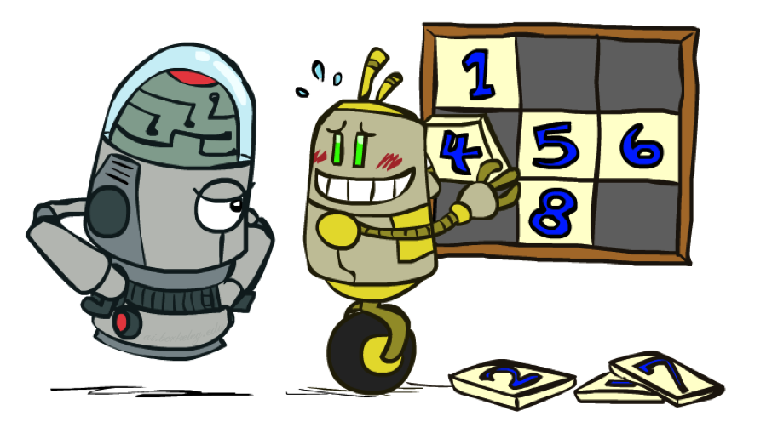
8 Puzzle I
Heuristic: Number of tiles misplaced
Why is it admissible?
h(start) =
This is a relaxed-problem heuristic
8
Start State
Goal State
 | Average nodes expanded when the optimal path has…
 | …4 steps | …8 steps | …12 steps
UCS | 112 | 6,300 | 3.6 x 10⁶
TILES | 13 | 39 | 227
Statistics from Andrew Moore
Notes:
Admissible (optimistic) heuristics slow down bad plans but never outweigh true costs

Slide 67
8 Puzzle II
What if we had an easier 8-puzzle where any tile could slide any direction at any time, ignoring other tiles?
Total Manhattan distance
Why is it admissible?
h(start) =
Start State
Goal State
 | Average nodes expanded when the optimal path has…
 | …4 steps | …8 steps | …12 steps
TILES | 13 | 39 | 227
MANHATTAN | 12 | 25 | 73
3 + 1 + 2 + … = 18
Notes:
Admissible (optimistic) heuristics slow down bad plans but never outweigh true costs

Slide 68
8 Puzzle III
How about using the actual cost as a heuristic?
Would it be admissible?
Would we save on nodes expanded?
What’s wrong with it?
With A*: a trade-off between quality of estimate and work per node
As heuristics get closer to the true cost, you will expand fewer nodes but usually do more work per node to compute the heuristic itself
Notes:
true cost = 26
admissible because it does not over-estimate the true solution cost

Slide 69

A*: Summary
A* uses both path costs and heuristics
A* is optimal with admissible / consistent heuristics
Heuristic design is key: often use relaxed problems

Slide 70
Summary of Class
Review of Uninformed Search
BFS, DFS, UCS
Informed Search
Best First Search, Greedy Best First Search, A*
Evaluating Search Criteria
Complete, Optimal
Heuristics
Admissible Heuristics
Consistency

Slide 71
Next
In class assignment on Search
This assignment is graded!
You CAN work in pairs of 2
You CAN discuss methods
You CANNOT discuss or copy answers
You may leave class if you are done early
Please hand your solutions to your professor or your TA

